Slide 1
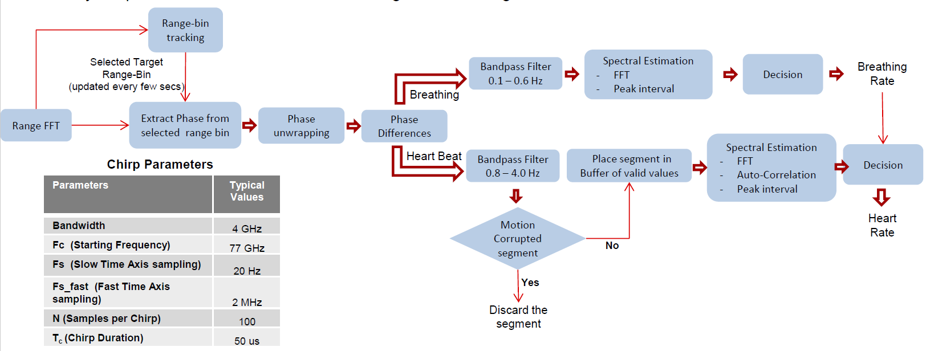
Non-Invasive and Standoff-distance Detection of Vital Signs using mm-Wave Sensor with Machine Learning
Deliverables:
Items | Proposed
A prototype development of mmWave radar sensor to detect non-invasive and non-contact vital signs. | 1
Technology Disclosures | 2
Patents | 1
Publications | 4
NTU PhD/Master students trained | 4
Objectives:
To design and develop an efficient mm-Wave FMCW/CW radar sensor to be able to detect non-invasive and non-contact vital signs at a distance of 1-3 meters.
To design and develop a miniature and high gain metamaterial based antenna.
To develop and apply machine learning techniques on the data generated from mm-Wave sensors to detect, analyze and predict the vital signs accurately.
Differentiators & Impact:
A miniature system-in-package (SiP) FMCW radar sensor to detect non-contact vital signs and also investigating the detection of blood pressure non-invasively.
A high gain metamaterial based antenna/array with a gain of > 7 dB
Machine learning techniques to accurately detect and predict vital signs.
A customer has shown keen interest in the technology
Parameters | Values
Start frequency | 77GHz
Idle time | 7 us
Ramp end time | 57us
Frequency slop constant | 70 Mhz/usec Total BW=70*57=3.99 GHz
No. of ADC samples | 256
ADC sampling freq | 4MHz
Number of Tx antennas used | 2
Number of Rx antennas used | 4
Angular resolution achieved | 15º
Range set | 30cm-100cm
Fig 1 : Workflow for implementation of mmWave vital signs monitoring

